Slide 1


Presentation
On
Price Tracker
Name: Mohammad Navid Nayyem
ID: 172014003
Department: CSE
Course Code: CSE401
Course Title: System Analysis and Design
Section: 01

Slide 2
OUTLINES
Introduction
Features List
Functional Requirements
Non-Functional Requirements
Entity-Relationship Diagram
Context Level Data-Flow Diagram
Data-Flow Diagram Level 1
Use Case Diagram of Price Tracker Website
Use Case Diagram of Price Tracker Extension
UML Class Diagram
Activity Diagram
Gantt Chart

Slide 3
INTRODUCTION
Browser Extension
Track, compare and analyze product price
A system for finding products at the cheapest price
Details of the price comparison in the custom-build Price Tracker website
Helpful for customer to save their valuable time and money

Slide 4
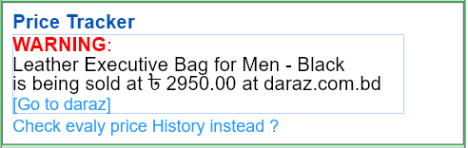

Features List
Compare product price between different e-commerce websites
Buy multiple quantity products
Shows warning and congratulations message to the users
Enhances user experience
User Friendly

Slide 5
Functional Requirements
Login or signup system
Product prices fetched
An alert warning message and link of the sites will be shown
History of the product price
A link will be created by Price Tracker browser extension
Price Tracker database will store product prices

Slide 6
Non-Functional Requirements
Store price history for each product for the last year
Not support Firefox or Opera browser and not work in smartphones
All passwords in the database must be hashed for security purposes
Price tracker will update prices of products every day

Slide 7
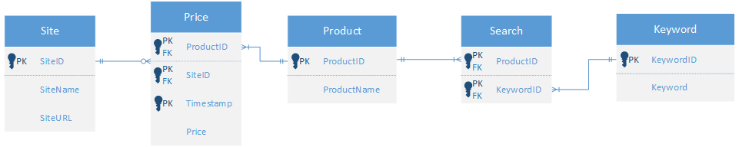
Entity-Relationship diagram

Slide 8
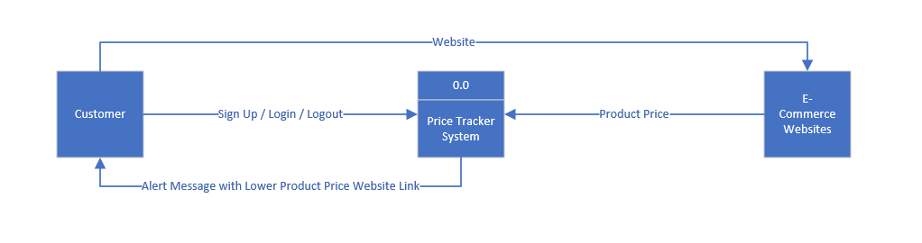
Context LEVEL Data-flow diagram

Slide 9
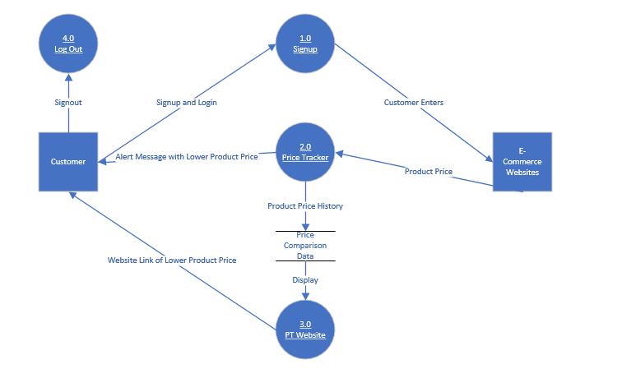
Data-flow diagram level 1

Slide 10
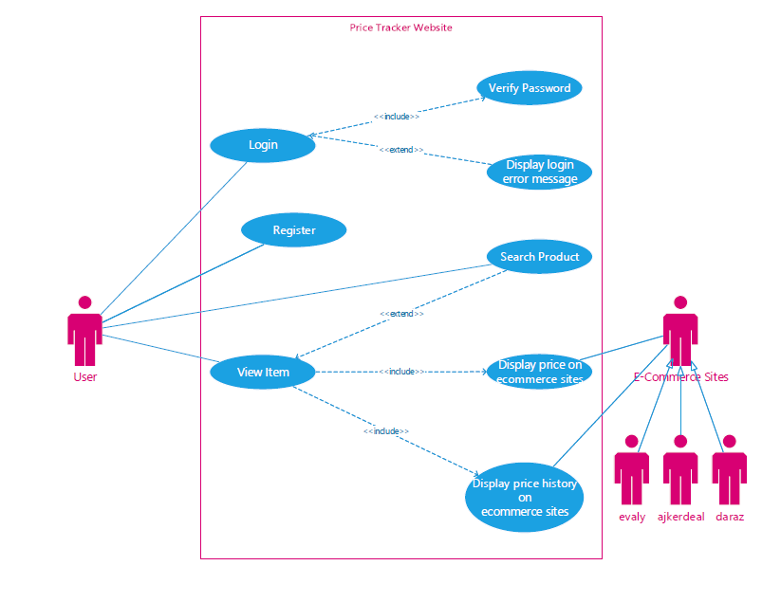
Use Case diagram of price tracker website

Slide 11
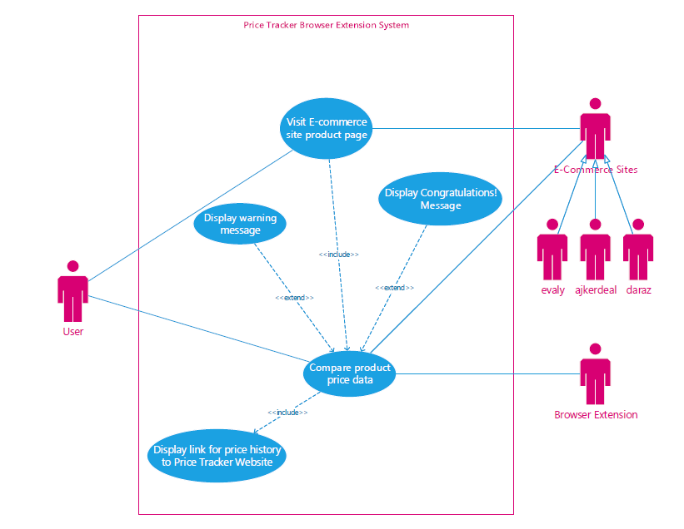
Use Case diagram of price tracker Extension System

Slide 12
UML CLASS diagram

Slide 13
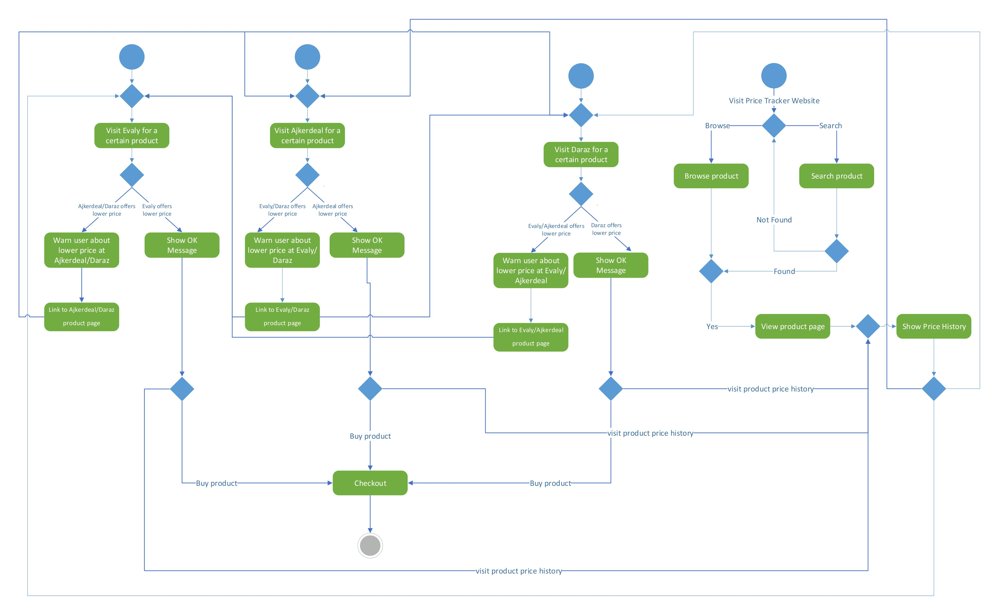
Activity diagram

Slide 14
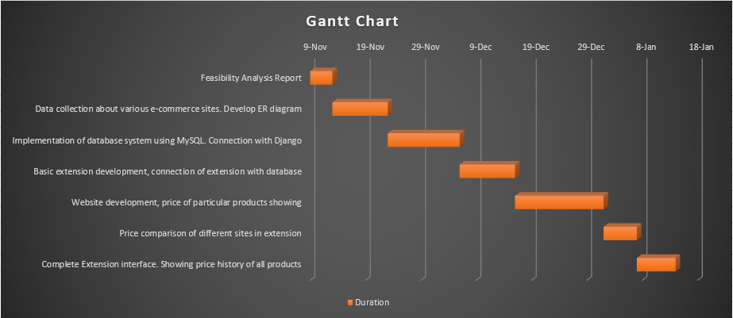
Gantt Chart

Slide 15


Thanks for watching

